Slide 1

CSCI 466: Networks
Lecture 4: Application Layer
Reese Pearsall
Fall 2022
https://www.cs.montana.edu/pearsall/classes/fall2022/466/main.html
*All images are stolen from the internet

Slide 2

Application Layer
OSI Model
Presentation Layer
*
Application Layer
Session Layer
*
Messages from Network Applications
Transport Layer
Network Layer
Physical Layer
Data Link Layer
Bits being transmitted over a copper wire
Physical Layer
*In the textbook, they condense it to a 5-layer model, but 7 layers is what is most used

Slide 3
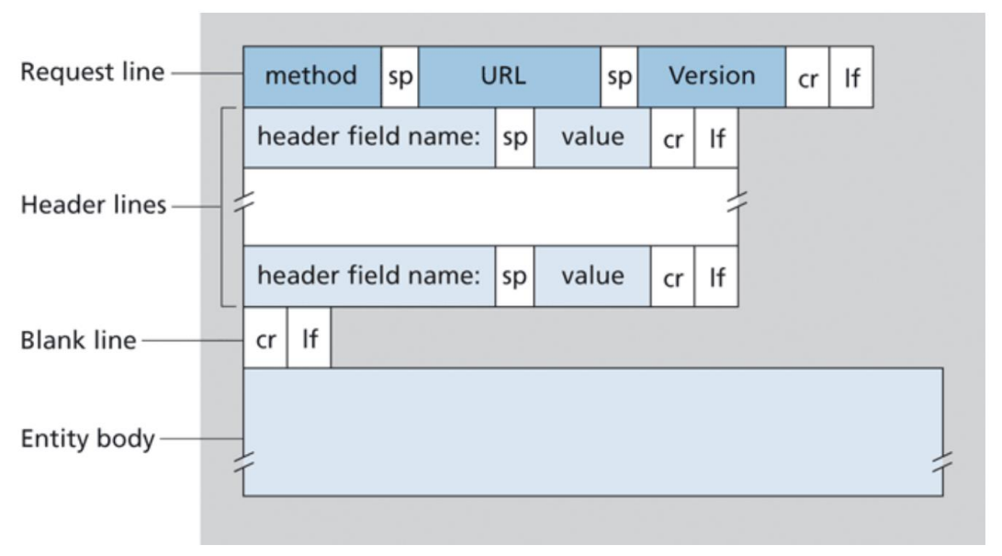
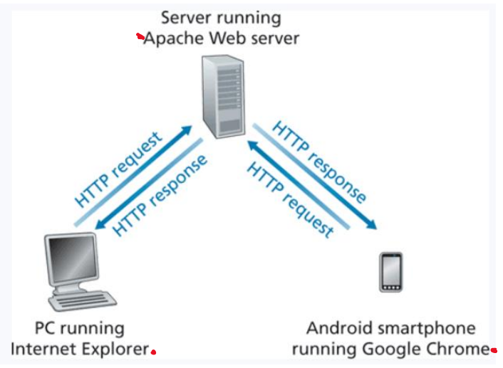
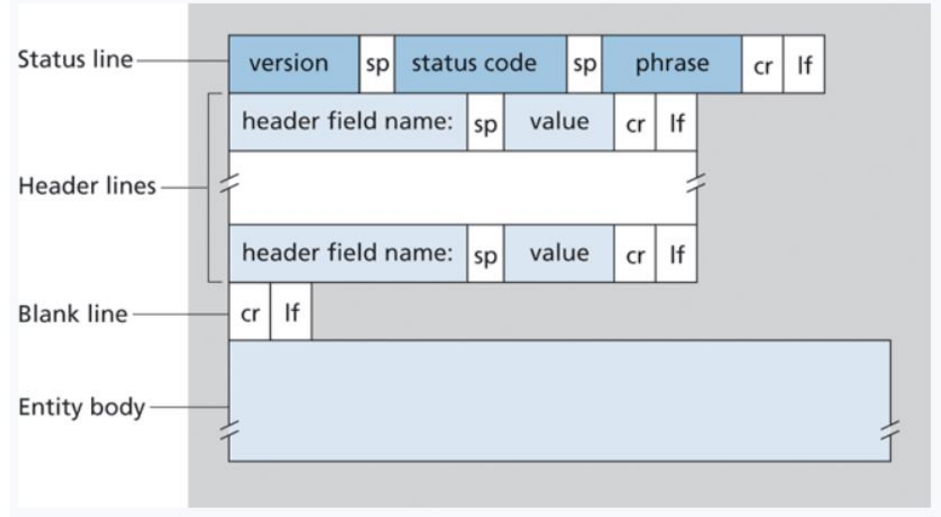
HyperText Transfer Protocol (HTTP)- protocol that dictates the transmitting of hypermedia documents such as HTML and other webpage objects
REQUEST
All web navigation is done through HTTP
RESPONSE

Slide 4
HyperText Transfer Protocol (HTTP)- protocol that dictates the transmitting of hypermedia documents such as HTML and other webpage objects
HTTPS- is the secure implementation of HTTP

Slide 5
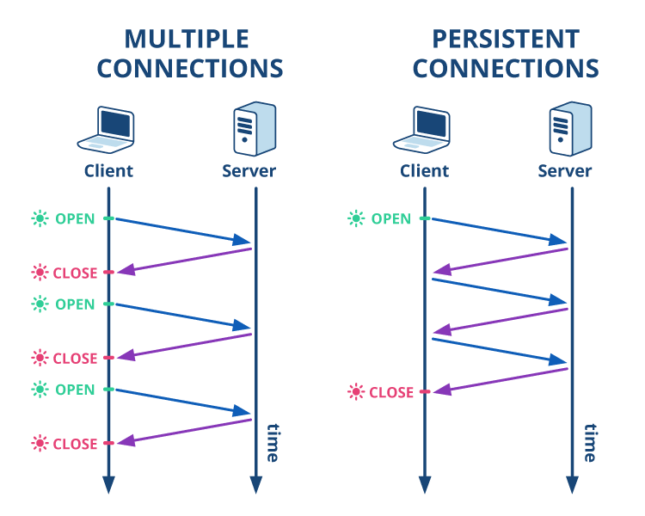
HyperText Transfer Protocol (HTTP)- protocol that dictates the transmitting of hypermedia documents such as HTML and other webpage objects
All web navigation is done through HTTP

Slide 6
The process of one computer establishing a connection with another computer or device is called a handshake
HyperText Transfer Protocol (HTTP)- protocol that dictates the transmitting of hypermedia documents such as HTML and other webpage objects
All web navigation is done through HTTP

Slide 7
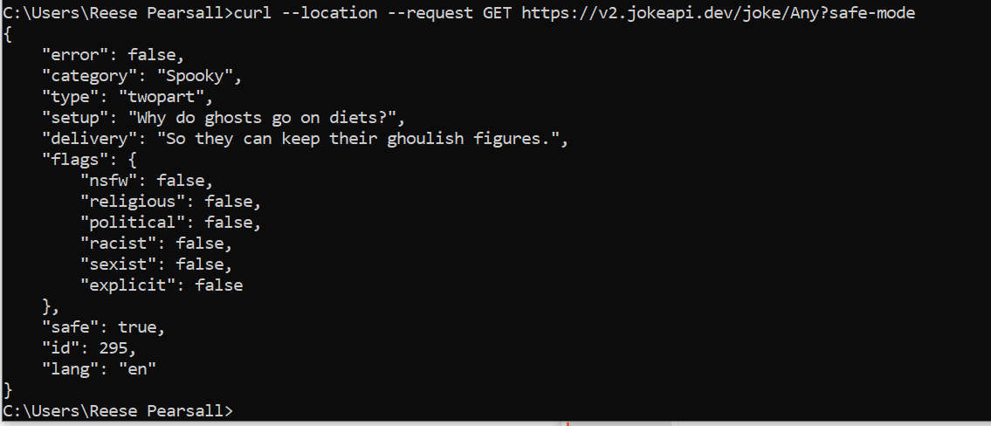
cURL requests

Slide 8
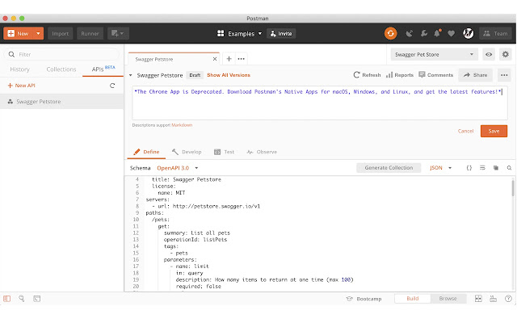
Postman

Slide 9
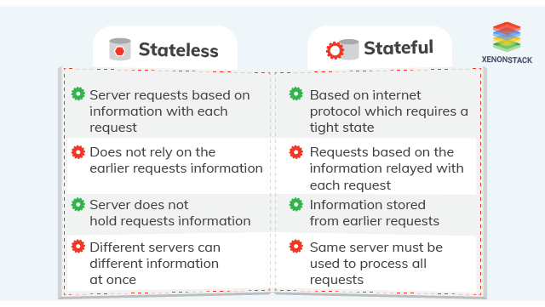
HTTP is a stateless protocol; it does not save information about the sender-receiver session and treats each user as a brand-new connection

Slide 10
HTTP is a stateless protocol; it does not save information about the sender-receiver session and treats each user as a brand-new connection
often it can be useful to identify a user.
User access and permissions
Dynamic continent

Slide 11

Cookies are pieces of information that are exchanged between browsers and web servers to identify users in active connections

Slide 12
Cookies are pieces of information that are exchanged between browsers and web servers to identify users in active connections
Authentication
Tracking & Advertisement
Session Management

Slide 13
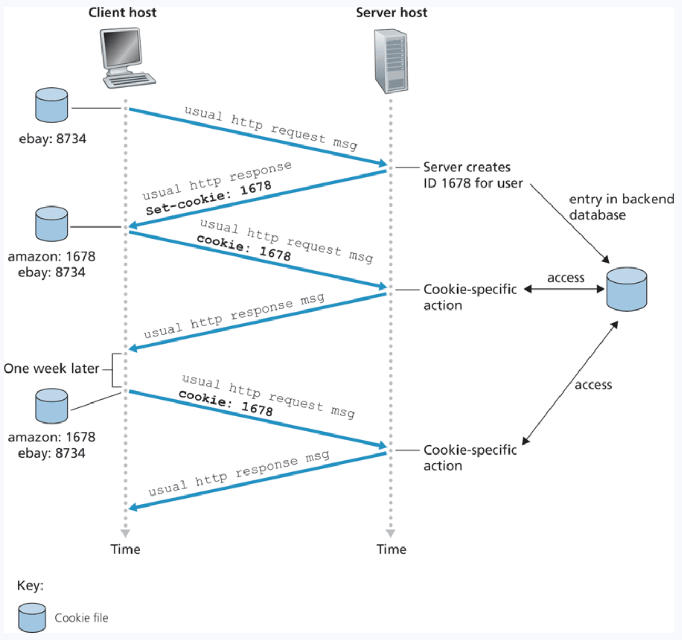
Cookies in HTTP
After sending a request to a webserver for the first time, the user is assigned a unique cookie value

Slide 14
Cookies in HTTP
After sending a request to a webserver for the first time, the user is assigned a unique cookie value
Cookie 1678 is created and stored in the user’s browser as well as some database backend on the server side

Slide 15
Cookies in HTTP
After sending a request to a webserver for the first time, the user is assigned a unique cookie value
Cookie 1678 is created and stored in the user’s browser as well as some database backend on the server side
When the user goes back to visit the website, the cookie will be exchanged between to client and host so the website can execute cookie-specific actions

Slide 16




Cookies in HTTP
After sending a request to a webserver for the first time, the user is assigned a unique cookie value
Cookie 1678 is created and stored in the user’s browser as well as some database backend on the server side
When the user goes back to visit the website, the cookie will be exchanged between to client and host so the website can execute cookie-specific actions
Cookie technology consists of four main components

Slide 17

Cookies in HTTP
After sending a request to a webserver for the first time, the user is assigned a unique cookie value
Cookie 1678 is created and stored in the user’s browser as well as some database backend on the server side
When the user goes back to visit the website, the cookie will be exchanged between to client and host so the website can execute cookie-specific actions
There is lots of controversy regarding the privacy and morality of tracking user information with cookies

Slide 18
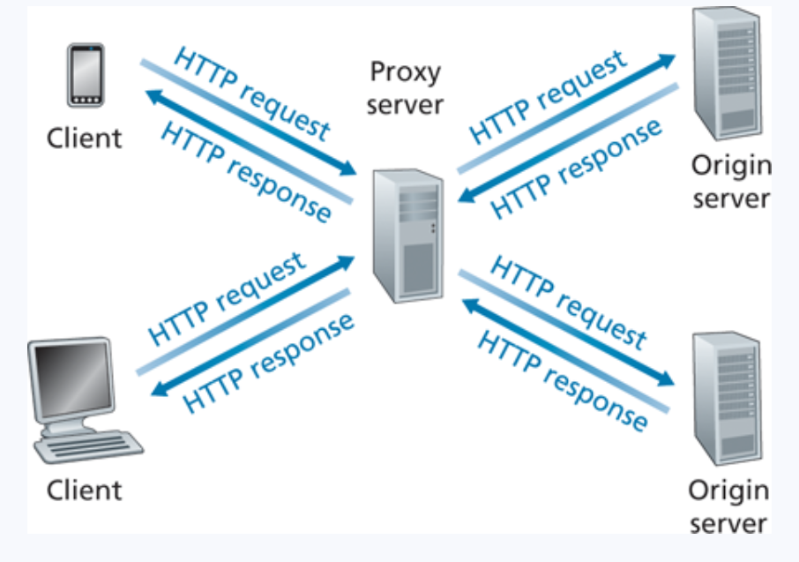
Web Caching
A web cache– also called a proxy server– is a network entity that satisfies HTTP requests on the behalf of an origin Web server

Slide 19
Web Caching
A web cache– also called a proxy server– is a network entity that satisfies HTTP requests on the behalf of an origin Web server
1. Browser/Client establishes a TCP connection to the Web cache and sends an HTTP request

Slide 20
Web Caching
A web cache– also called a proxy server– is a network entity that satisfies HTTP requests on the behalf of an origin Web server
1. Browser/Client establishes a TCP connection to the Web cache and sends an HTTP request
2. Web cache checks its local storage for the requested object

Slide 21
Web Caching
A web cache– also called a proxy server– is a network entity that satisfies HTTP requests on the behalf of an origin Web server
1. Browser/Client establishes a TCP connection to the Web cache and sends an HTTP request
2. Web cache checks its local storage for the requested object
3. If the web cache does not have the object, establish TCP with an origin server and issue an HTTP request

Slide 22
Web Caching
A web cache– also called a proxy server– is a network entity that satisfies HTTP requests on the behalf of an origin Web server
1. Browser/Client establishes a TCP connection to the Web cache and sends an HTTP request
2. Web cache checks its local storage for the requested object
3. If the web cache does not have the object, establish TCP with an origin server and issue an HTTP request
4. Web cache stores a local copy of the object, then issues an HTTP response with the object

Slide 23
Web Caching
Typically installed and maintained by an ISP
A web cache– also called a proxy server– is a network entity that satisfies HTTP requests on the behalf of an origin Web server

Slide 24
Web Caching
Typically installed and maintained by an ISP
A web cache– also called a proxy server– is a network entity that satisfies HTTP requests on the behalf of an origin Web server
* Improves response time (especially if the the cache has the object that is requested)
* The connection from the client to the cache is typically much faster than the connection from client to host server

Slide 25
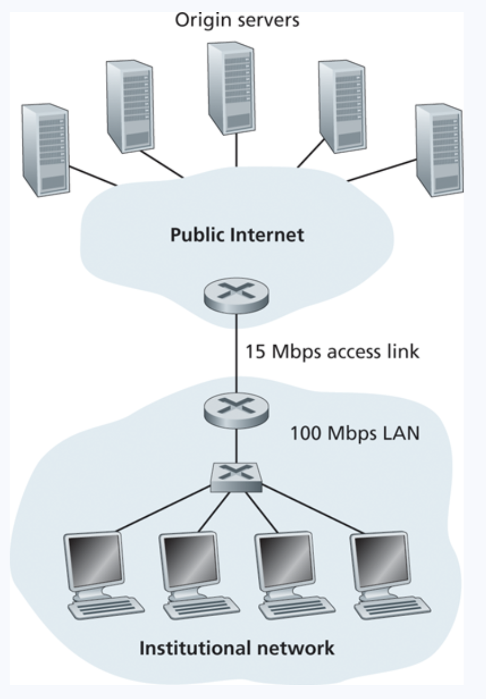
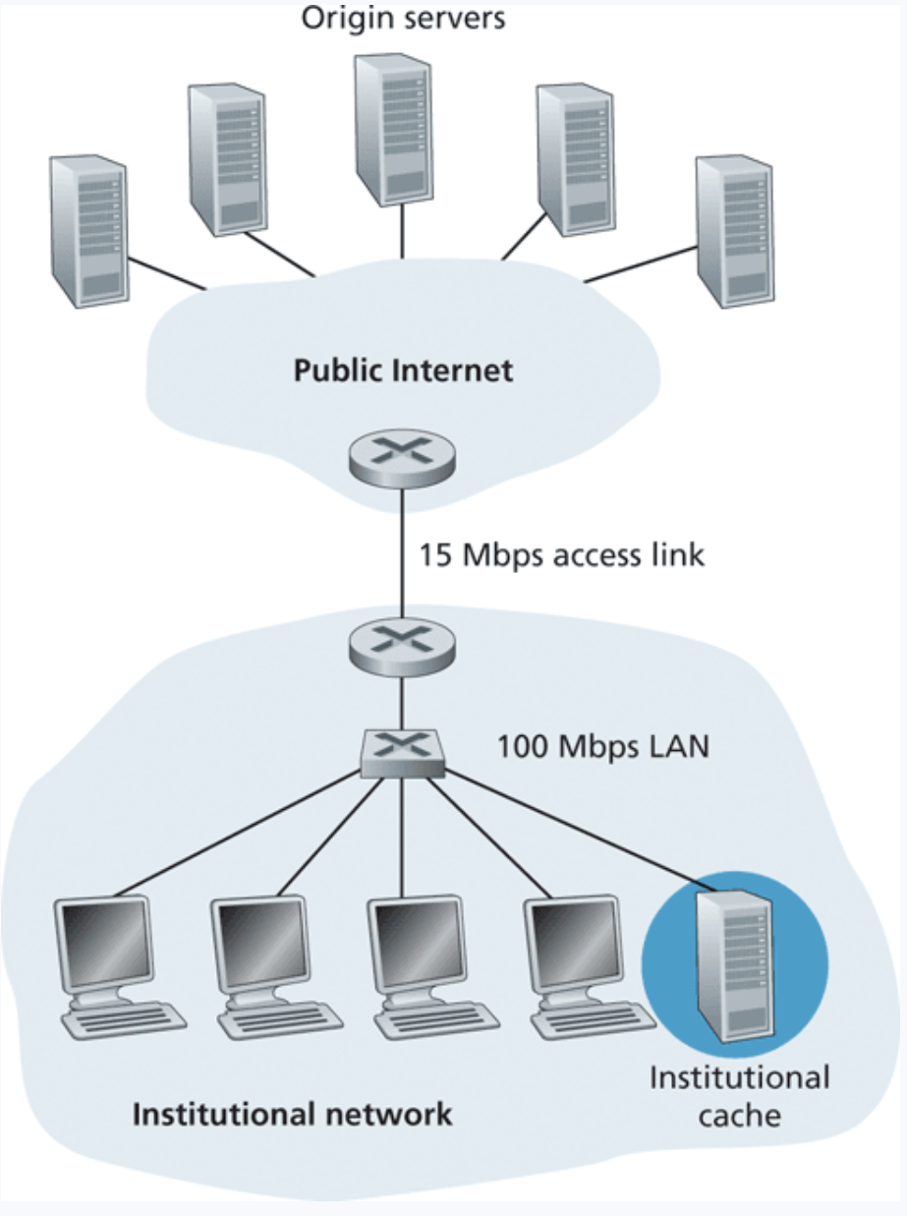
Web Caching

Slide 26

Web Caching
The cache might not always have the most up to date version in its local storage. “Stale” objects

Slide 27


Web Caching
Proxy Server
The cache might not always have the most up to date version in its local storage. “Stale” objects
Origin Server

Slide 28
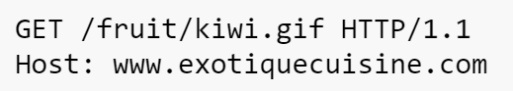
Web Caching
Proxy Server
The cache might not always have the most up to date version in its local storage. “Stale” objects
Origin Server

Slide 29
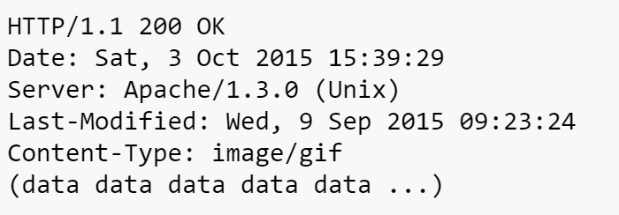


Web Caching
Proxy Server
The cache might not always have the most up to date version in its local storage. “Stale” objects
Origin Server

Slide 30
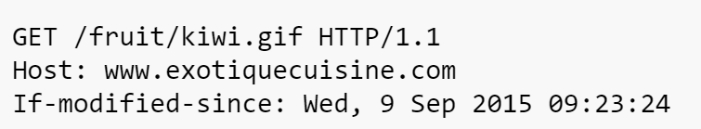
Web Caching
Proxy Server
The cache might not always have the most up to date version in its local storage. “Stale” objects
We can issue a conditional GET request to retrieve an object only if it's been recently modified
Origin Server

Slide 31
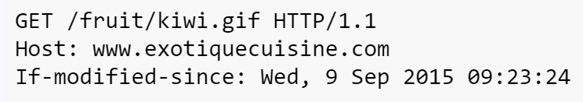
Web Caching
Proxy Server
The cache might not always have the most up to date version in its local storage. “Stale” objects
We can issue a conditional GET request to retrieve an object only if it's been recently modified
Origin Server

Slide 32
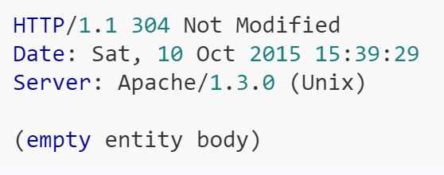
Web Caching
Proxy Server
The cache might not always have the most up to date version in its local storage. “Stale” objects
We can issue a conditional GET request to retrieve an object only if it's been recently modified
Origin Server

Slide 33
SMTP
Simple Mail Transfer Protocol (SMTP) is the protocol used for sending e-mails from one server to another

Slide 34

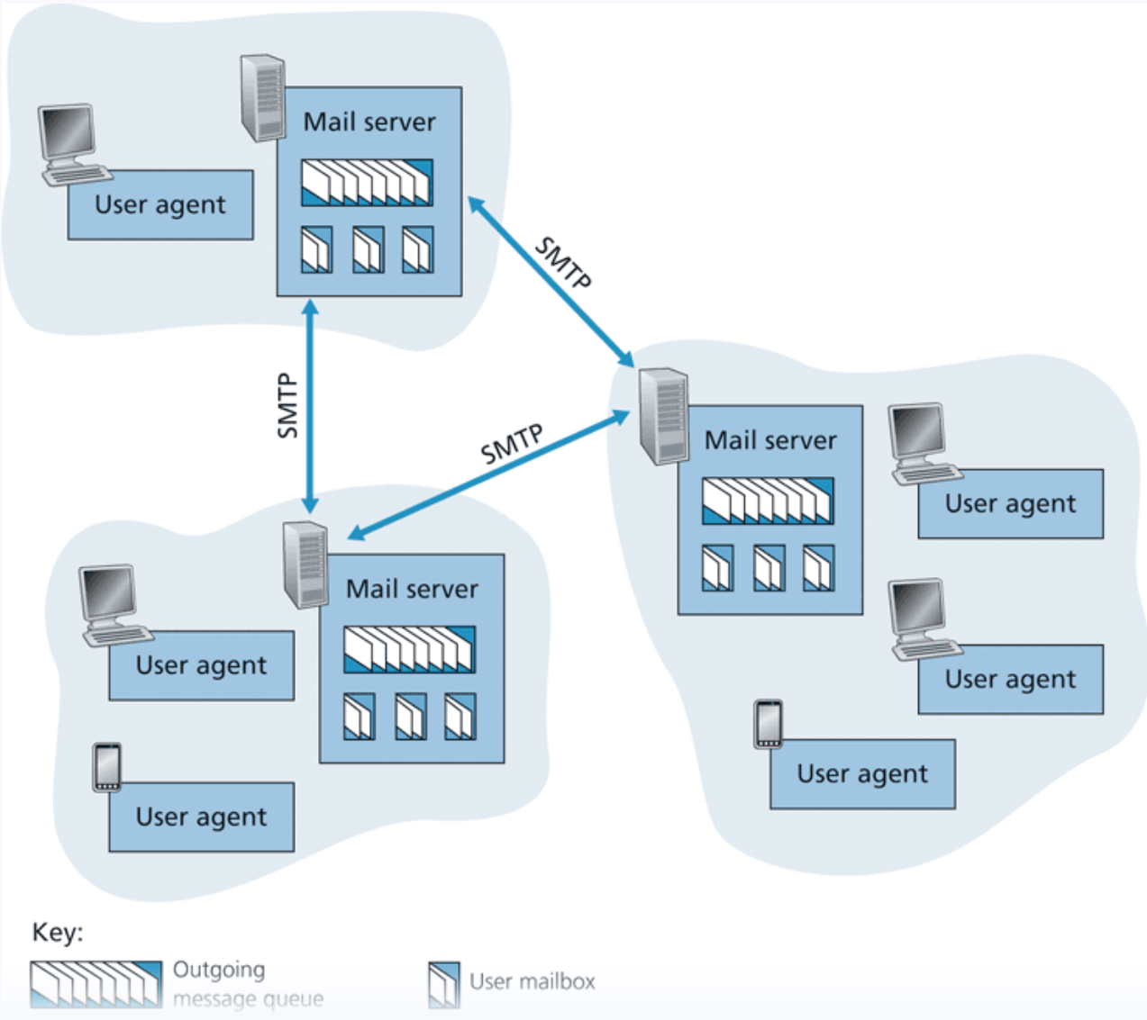


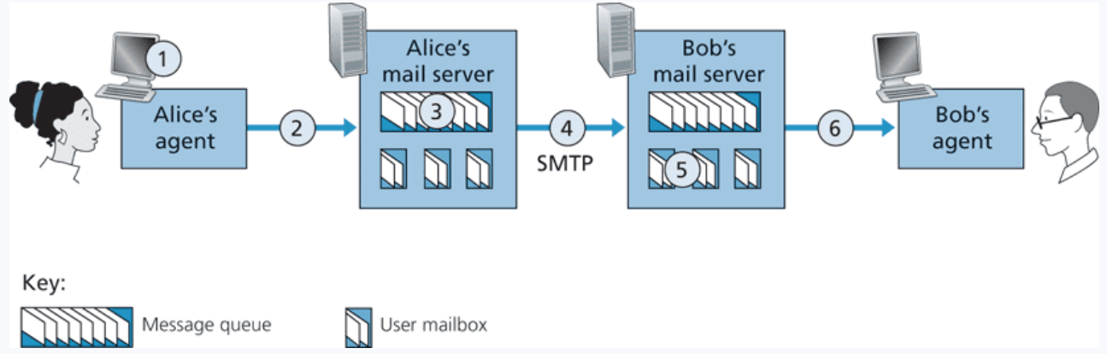
SMTP
Simple Mail Transfer Protocol (SMTP) is the protocol used for sending e-mails from one server to another
This is not a protocol for retrieving emails

Slide 35
SMTP
Simple Mail Transfer Protocol (SMTP) is the protocol used for sending e-mails from one server to another
This is not a protocol for retrieving emails
STMP uses TCP for the end-to-end delivery

Slide 36
SMTP
POP3 (post office protocol) or IMAP (internet message access protocol) are used to retrieve emails from mail servers.

Slide 37
SMTP
POP3 (post office protocol) or IMAP (internet message access protocol) are used to retrieve emails from mail servers.
POP3 deletes the email of the web server, IMAP maintains a copy to synchronize across multiple devices

Slide 38
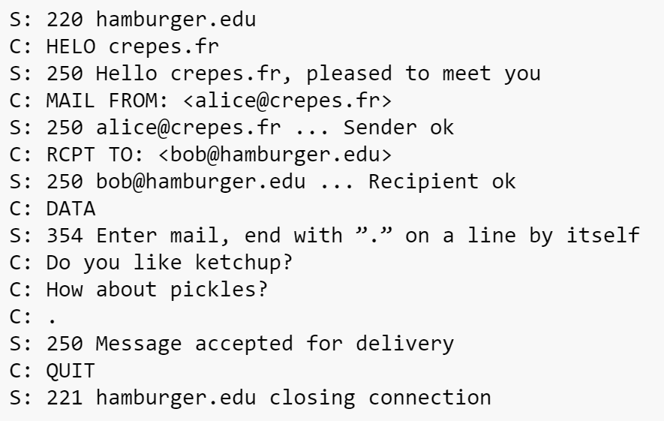






SMTP
(Very verbose)

Slide 39
Announcements
Homework 1 due TONIGHT @ 11:59 PM

Slide 40
SMTP
Simple Mail Transfer Protocol (SMTP) is the protocol used for sending e-mails from one server to another asynchronously
Ports 25 is reserved for SMTP traffic (and also port 587 & 465)

Slide 41

FTP
File Transfer Protocol (FTP)- protocol used for transferring files from server to client
FTP procedure:
FTP client contacts FTP server at port 21, using TCP
Client authorized over control connection
Client browses remote directory, sends commands over control connection
When server receives file transfer command, server opens 2nd TCP data connection (for file) to client
After transferring one file, server closes data connection
TCP control connection,
server port 21
FTP
client
TCP data connection,
server port 20
FTP
server
FTP communicates over two connections
Port 21 for control information
Port 20 for data
Differences from HTTP
Control communication “out-of-band”
Server maintains per client state: authentication, current directory
Why use a separate control connection?

Slide 42
DNS
Humans browse the web using hostnames
(They need English)
Computers understand numbers
(They need IP addresses)

Slide 43


DNS
Humans browse the web using hostnames
(They need English)
Computers understand numbers
(They need IP addresses)
153.90.127.197

Slide 44

DNS
Humans browse the web using hostnames
(They need English)
Computers understand numbers
(They need IP addresses)
DNS
153.90.127.197
Domain Name System (DNS) is a database of mappings between hostnames and IP addresses

Slide 45

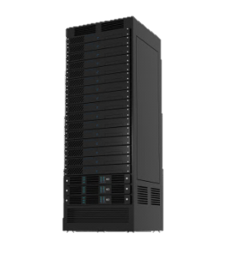
DNS Architecture
youtube.com
irs.gov
Clients will first need to resolve hostnames with DNS
montana.edu
3.
DNS
HTTP
1.
153.90.3.95
montana.edu ?
153.90.3.95
2.
Clients

Slide 46
DNS Architecture
youtube.com
irs.gov
Clients will first need to resolve hostnames with DNS
montana.edu
3.
DNS
HTTP
1.
153.90.3.95
montana.edu ?
153.90.3.95
Is this a good architecture?
2.
Clients

Slide 47
DNS Architecture
youtube.com
irs.gov
Clients will first need to resolve hostnames with DNS
montana.edu
3.
DNS
HTTP
1.
153.90.3.95
montana.edu ?
Single point of failure…
153.90.3.95
Is this a good architecture?
2.
Clients

Slide 48
DNS Architecture
youtube.com
irs.gov
montana.edu
DNS
DNS
DNS
.gov
.com
.edu
Clients

Slide 49
DNS Architecture
(how big would that map be?)
DNS is a distributed, hierarchical database (no DNS server has all the records!)
Hierarchy consists of different types of DNS servers:

Slide 50
DNS Architecture
DNS is a distributed, hierarchical database (no DNS server has all the records!)
Hierarchy consists of different types of DNS servers:
Authoritative DNS servers- Organization’s own DNS with up-to-date records
facebook.com DNS
amazon.com DNS
montana.edu DNS
harvard.edu DNS

Slide 51




DNS Architecture
DNS is a distributed, hierarchical database (no DNS server has all the records!)
Hierarchy consists of different types of DNS servers:
Authoritative DNS servers- Organization’s own DNS with up-to-date records
.com TLD DNS server
.edu TLD DNS server
Top-level domain (TLD) servers- responsible for keeping IP addresses for authoritative DNS servers for each top-level domain (.com, .edu, .jp, etc)
facebook.com DNS
amazon.com DNS
montana.edu DNS
harvard.edu DNS

Slide 52




DNS Architecture
DNS is a distributed, hierarchical database (no DNS server has all the records!)
Hierarchy consists of different types of DNS servers:
Authoritative DNS servers- Organization’s own DNS with up-to-date records
.com TLD DNS server
.edu TLD DNS server
Top-level domain (TLD) servers- responsible for keeping IP addresses for authoritative DNS servers for each top-level domain (.com, .edu, .jp, etc)
facebook.com DNS
amazon.com DNS
montana.edu DNS
harvard.edu DNS

Slide 53


DNS Architecture
DNS is a distributed, hierarchical database (no DNS server has all the records!)
Hierarchy consists of different types of DNS servers:
root DNS server
Authoritative DNS servers- Organization’s own DNS with up-to-date records
.com TLD DNS server
.edu TLD DNS server
Top-level domain (TLD) servers- responsible for keeping IP addresses for authoritative DNS servers for each top-level domain (.com, .edu, .jp, etc)
facebook.com DNS
amazon.com DNS
montana.edu DNS
harvard.edu DNS
Root DNS servers- responsible for maintaining IP addresses for TLD servers

Slide 54


DNS Architecture
DNS is a distributed, hierarchical database (no DNS server has all the records!)
Hierarchy consists of different types of DNS servers:
root DNS server
Authoritative DNS servers- Organization’s own DNS with up-to-date records
.com TLD DNS server
.edu TLD DNS server
Top-level domain (TLD) servers- responsible for keeping IP addresses for authoritative DNS servers for each top-level domain (.com, .edu, .jp, etc)
facebook.com DNS
amazon.com DNS
montana.edu DNS
harvard.edu DNS
Root DNS servers- responsible for maintaining IP addresses for TLD servers

Slide 55
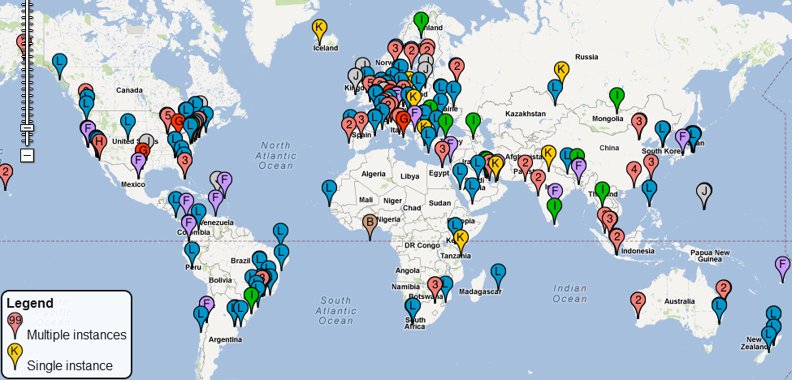
DNS Root server locations
https://root-servers.org/

Slide 56

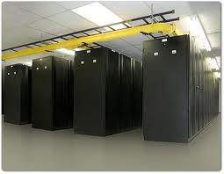
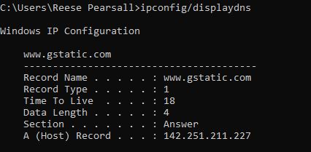

DNS
Client
DNS
Server
Application layer protocol
Lookups over UDP on port 53
montana.edu
???
(handshake not needed)
(DNS requests are small)
(reliability can be added in the application layer)
DNS lookup
153.90.3.95
Local DNS servers are also used
Acts as a proxy
Maintained by ISP
Caches records
Root DNS Servers
Some DNS records are also stored and maintained in your computer
Any issues??
com DNS servers
org DNS servers
edu DNS servers
yahoo.com
DNS servers
amazon.com
DNS servers
pbs.org
DNS servers
poly.edu
DNS servers
umass.edu
DNS servers
What if an IP address gets changed?

Slide 57
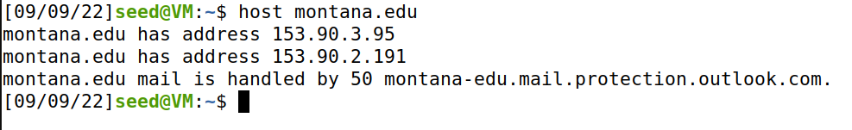
DNS Commands
DNS services
Hostname to IP address translation
host montana.edu
Hostname to IPv6 address translation
host -t AAAA montana.edu
Host aliasing
host -t CNAME img.huffingtonpost.com
Mail server aliasing
host -t MX montana.edu
Load distribution
host huffpost.com | grep "address" | sed -n -e 's/^.*address //p'
Redirection
Look up same host from servers in different regions
host google.com 8.8.8.8
153.90.3.95
(nslookup also works)

Slide 58
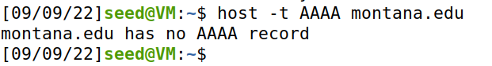
DNS Commands
DNS services
Hostname to IP address translation
host montana.edu
Hostname to IPv6 address translation
host -t AAAA montana.edu
Host aliasing
host -t CNAME img.huffingtonpost.com
Mail server aliasing
host -t MX montana.edu
Load distribution
host huffpost.com | grep "address" | sed -n -e 's/^.*address //p'
Redirection
Look up same host from servers in different regions
host google.com 8.8.8.8

Slide 59
DNS Commands
DNS services
Hostname to IP address translation
host montana.edu
Hostname to IPv6 address translation
host -t AAAA montana.edu
Host aliasing
host -t CNAME img.huffingtonpost.com
Mail server aliasing
host -t MX montana.edu
Load distribution
host huffpost.com | grep "address" | sed -n -e 's/^.*address //p'
Redirection
Look up same host from servers in different regions
host google.com 8.8.8.8

Slide 60
DNS Commands
DNS services
Hostname to IP address translation
host montana.edu
Hostname to IPv6 address translation
host -t AAAA montana.edu
Host aliasing
host -t CNAME img.huffingtonpost.com
Mail server aliasing
host -t MX montana.edu
Load distribution
host huffpost.com | grep "address" | sed -n -e 's/^.*address //p'
Redirection
Look up same host from servers in different regions
host google.com 8.8.8.8

Slide 61
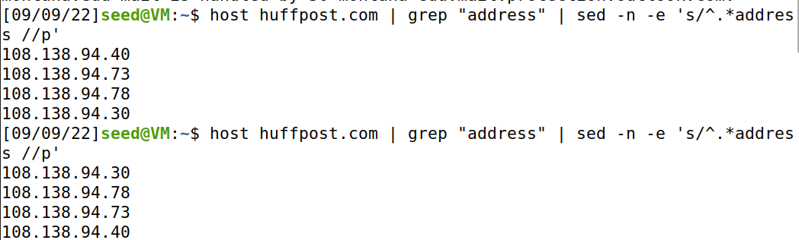
DNS Commands
DNS services
Hostname to IP address translation
host montana.edu
Hostname to IPv6 address translation
host -t AAAA montana.edu
Host aliasing
host -t CNAME img.huffingtonpost.com
Mail server aliasing
host -t MX montana.edu
Load distribution
host huffpost.com | grep "address" | sed -n -e 's/^.*address //p'
Redirection
Look up same host from servers in different regions
host google.com 8.8.8.8
Rotation!

Slide 62
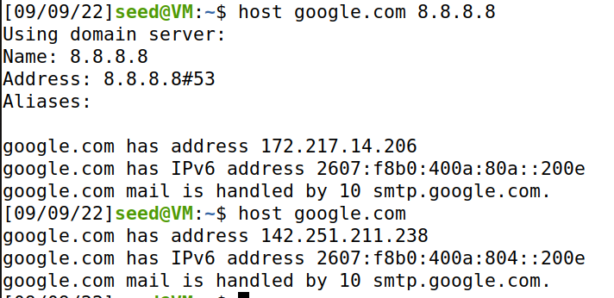

DNS Commands
DNS services
Hostname to IP address translation
host montana.edu
Hostname to IPv6 address translation
host -t AAAA montana.edu
Host aliasing
host -t CNAME img.huffingtonpost.com
Mail server aliasing
host -t MX montana.edu
Load distribution
host huffpost.com | grep "address" | sed -n -e 's/^.*address //p'
Redirection
Look up same host from servers in different regions
host google.com 8.8.8.8

Slide 63
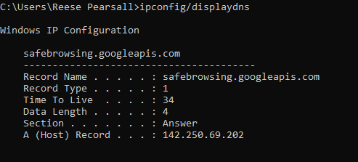
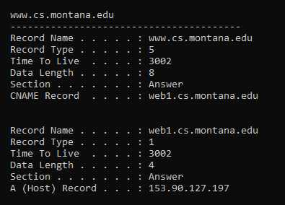
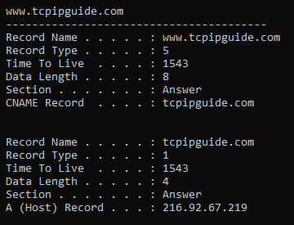
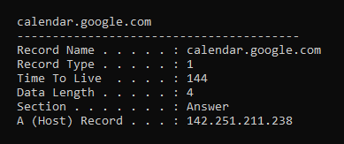
DNS Commands
DNS services
Hostname to IP address translation
host montana.edu
Hostname to IPv6 address translation
host -t AAAA montana.edu
Host aliasing
host -t CNAME img.huffingtonpost.com
Mail server aliasing
host -t MX montana.edu
Load distribution
host huffpost.com | grep "address" | sed -n -e 's/^.*address //p'
Redirection
Look up same host from servers in different regions
host google.com 8.8.8.8
See cached DNS entries on computer
ipconfig/displaydns

Slide 64
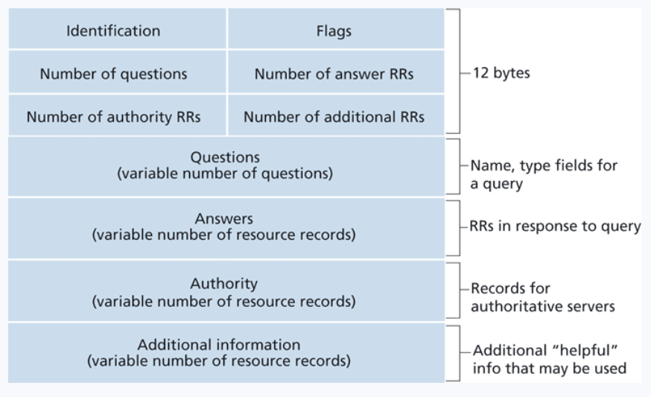
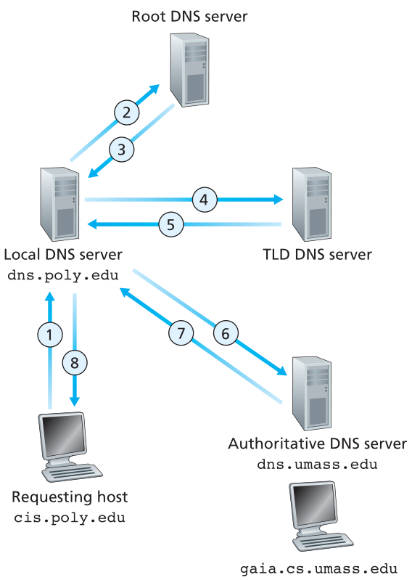
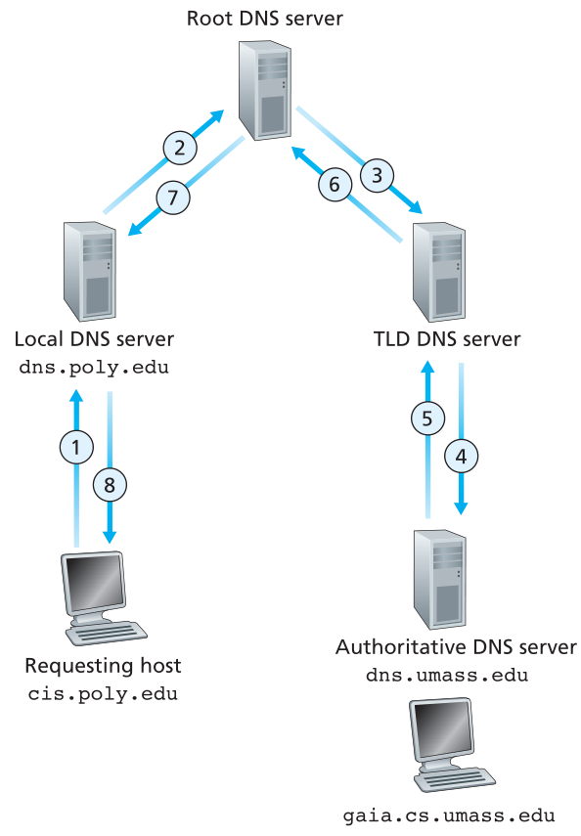
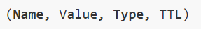
DNS Requests
Is there a better option?
DNS
DNS servers store resource records (RRs)
Iterative Lookup
Recursive Lookup

